Slide 1
KMOU Division of Marine System Engineering
Introduction to
Internal Combustion Engine

Slide 2
Lesson content for each week
Ch0_Introduction to the Class | Ch6_Piston Fittings and Crankshaft
Ch1_Overview of the Internal Combustion Engine | Ch7_Lube Oil System
Ch2_Thermodynamics and Compressed Air System | Ch8_Cooling Water System
Ch3_Marine Fuels and Internal Fuel Oil System | Ch9_Introduction to the Main Engine
Ch4_Intake and Exhaust System | Ch10_Alternative Fuels and Alternative Fuel Systems
Ch5_Turbocharger | Ch11_Environmental Regulations and Exhaust Gas Aftertreatment Systems
Midterm | Ch12_Tools, Apprentice Engineer Duties, and Career Direction
 | Final Exam

Slide 3
Thermodynamics
What is Thermodynamics?
Thermodynamics is a branch of physics which deals with the energy and work of a system.
It was born in the 19th century as scientists were first discovering how to build and operate steam engines.
Thermodynamics deals only with the large scale response of a system which we can observe and measure in experiments. Small scale gas interactions are described by the kinetic theory of gases.

Slide 4
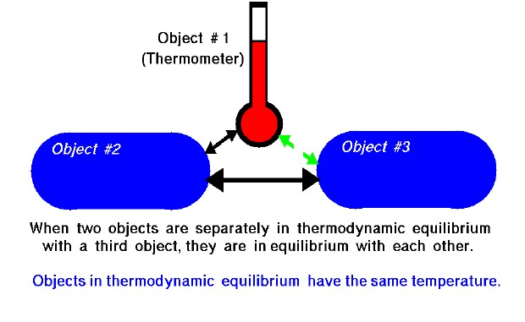
Zeroth Law of Thermodynamics
What is the “Zeroth Law of Thermodynamics”?
→ If two systems are each in thermal equilibrium with a third system, then the two systems are in thermal equilibrium with each other.
Notes:
Thermodynamic equilibrium : 열역학적 평형

Slide 5
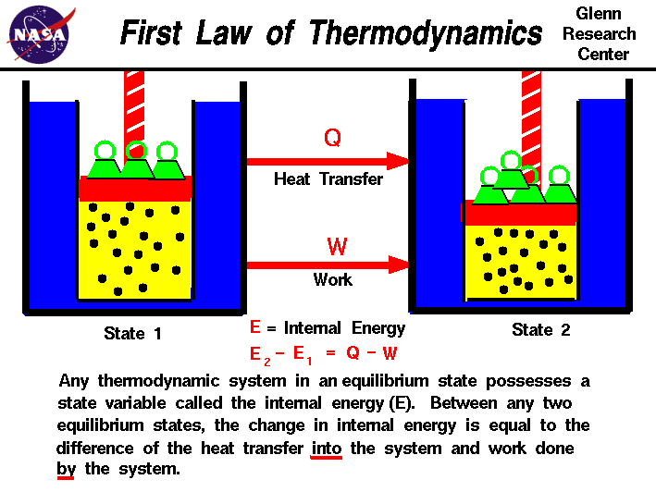
First Law of Thermodynamics
What is the “First Law of Thermodynamics”?
→ Energy is neither created nor destroyed, it only changes form.

Slide 6
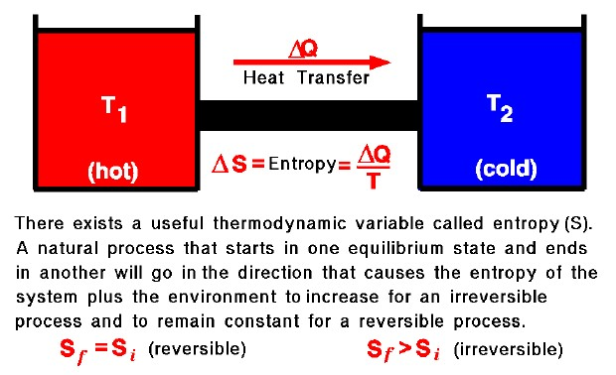
Second Law of Thermodynamics
What is the “Second Law of Thermodynamics”?
→ The entropy of an isolated system always increases or remains constant. (Natural processes proceed in the direction of increasing entropy.)

Slide 7
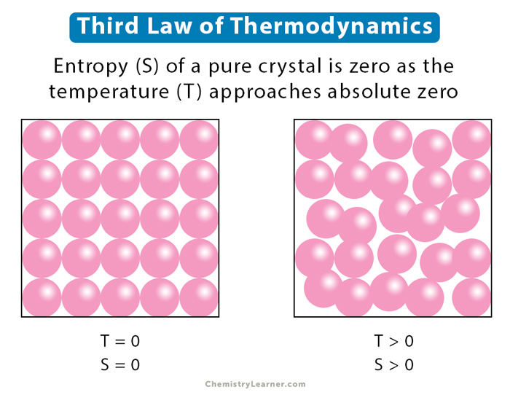
Third Law of Thermodynamics
What is the “Third Law of Thermodynamics”?
→ The entropy of a closed system at thermodynamic equilibrium approaches a constant value when its temperature approaches absolute zero.

Slide 8
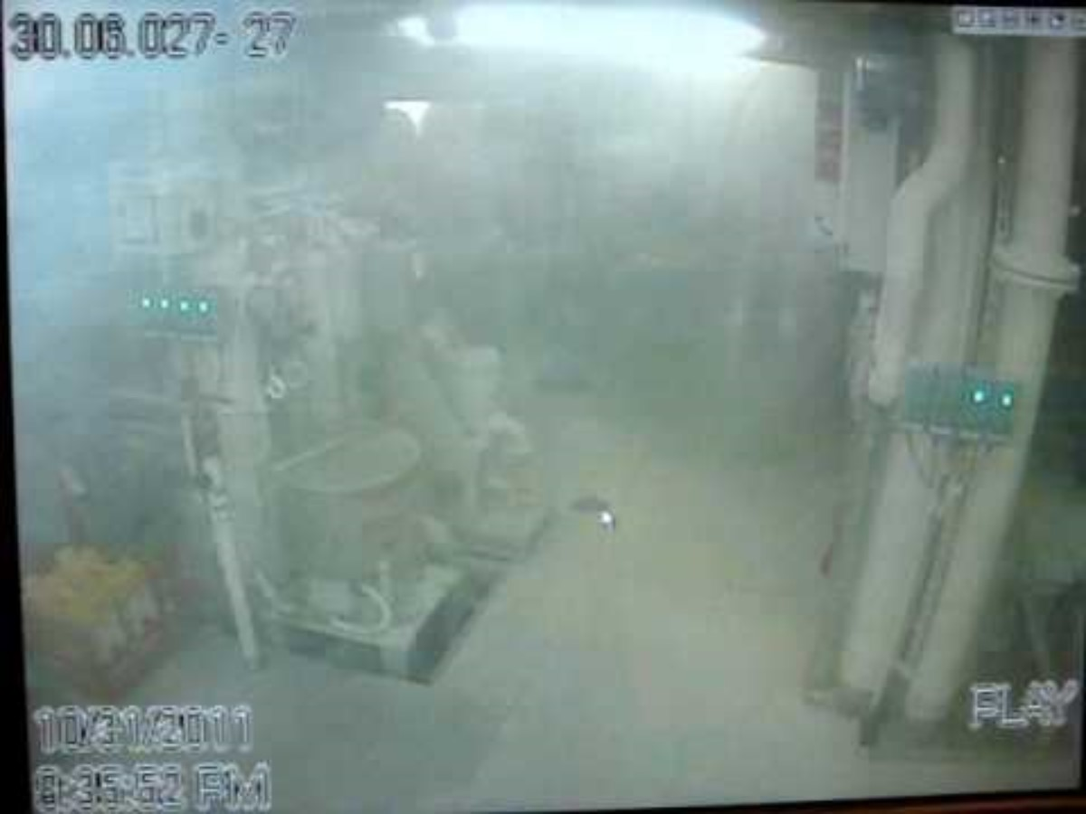
4-stroke ICE (G/E)

Slide 9
4-stroke ICE (G/E)
This class (Internal Combustion Engine) will mainly cover the content for G/E.
Why this class mainly covers for G/E?
1) Most of the students for this class will be onboard soon as an apprentice engineer (A/E).
2) There must be a chance of attending maintenance works for G/E with 2nd engineer.
3) Most of the students for this class will be onboard as a 3rd engineer and then be 2nd engineer before finishing military service.
4) 2nd engineer is in charge of G/E.
5) There will not be the education for G/E after graduation of university. (In my experience, company did not teach for G/E and I had to study by myself when I was 3rd and 2nd engineer.)
6) Therefore, I hope all students get benefit from this class for the knowledge of G/E.
7) At the end of class, I will shortly introduce for M/E too.

Slide 10



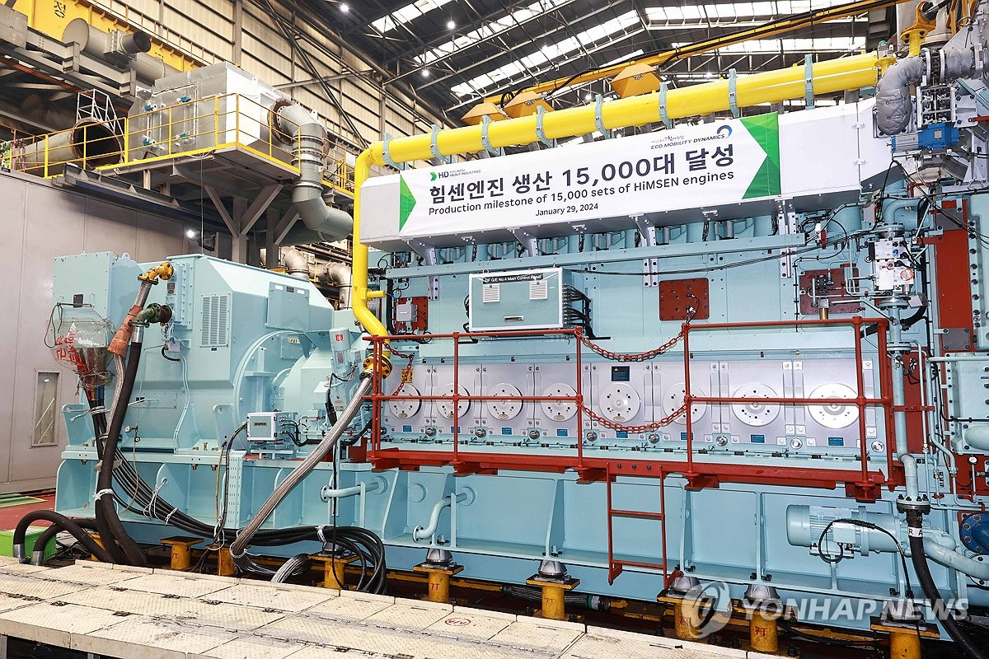
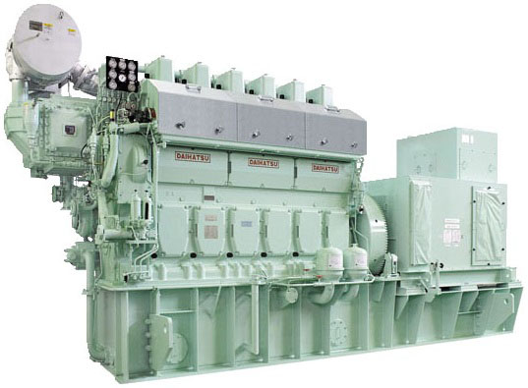


4-stroke ICE (G/E)
There are several makers of G/E that you will encounter when boarding a ship.
Some of them are shown in below.
(S.Korea)
(Japan)

Slide 11



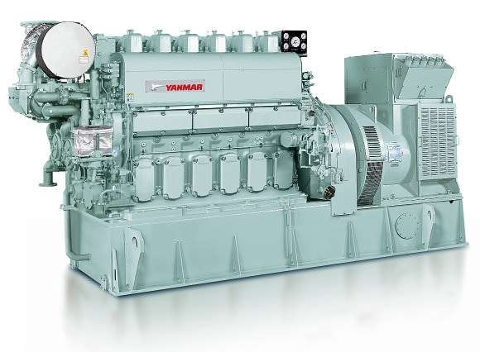
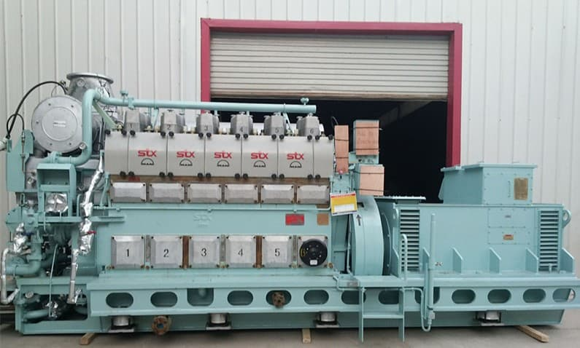



4-stroke ICE (G/E)
There are several makers of G/E that you will encounter when boarding a ship.
Some of them are shown in below.
(Japan)
(Germany)

Slide 12

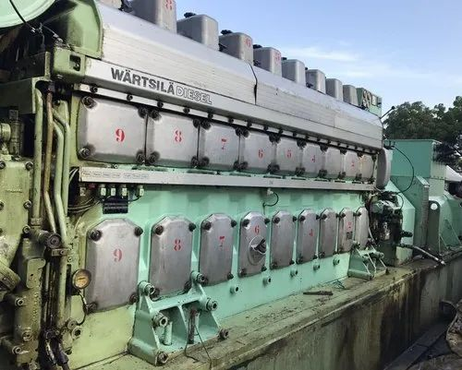
4-stroke ICE (G/E)
There are several makers of G/E that you will encounter when boarding a ship.
Some of them are shown in below.
You will encounter the G/E of the five brands described above when you board the ship.
Most ships recently built in Korean shipyards and owned by Korean shipowners are equipped with HiMSEN engines.
As you may have noticed, the G/E of all brands looks similar.
As they look similar, the structure and operating mechanism of all G/Es are almost identical.
Therefore, if you fully understand the G/E of just one brand, you will have no problem understanding the G/E of other brands.
(Finland)

Slide 13
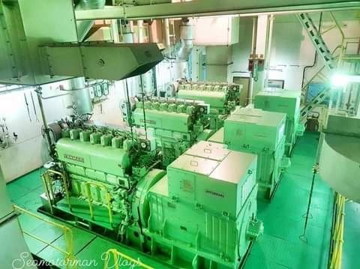
4-stroke ICE (G/E)
As explained in Chapter 1, G/E is divided into the Engine side and the Generator side.
The Engine side generates rotational force to the crankshaft through the reciprocating motion of the piston.
The Generator side uses the rotational power of the crankshaft to produce electricity from the generator.
A ship usually has 3 to 4 G/Es installed.
Generator Engine (G/E)
Engine
Generator

Slide 14
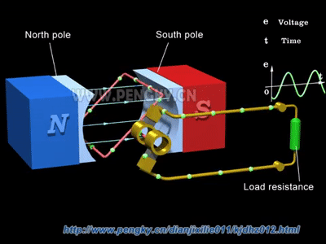
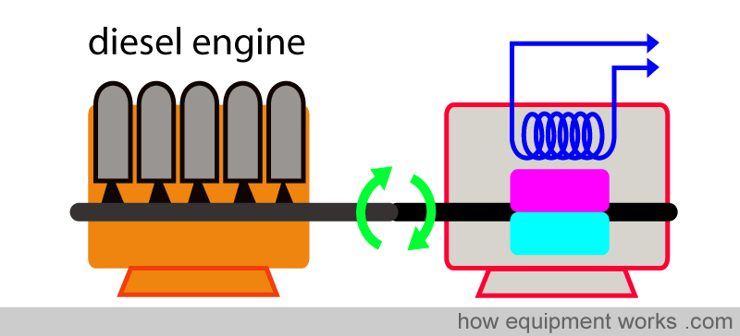
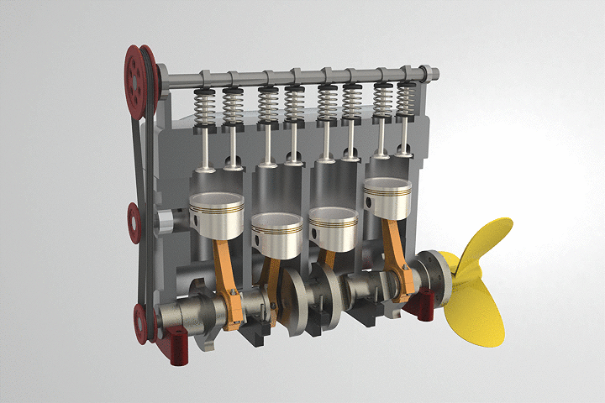
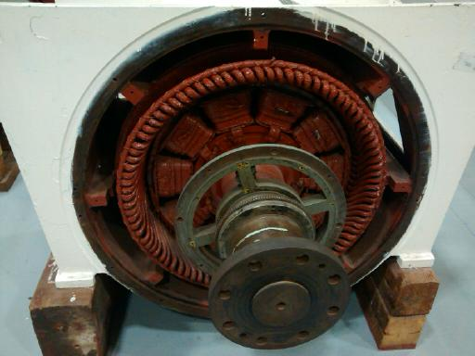
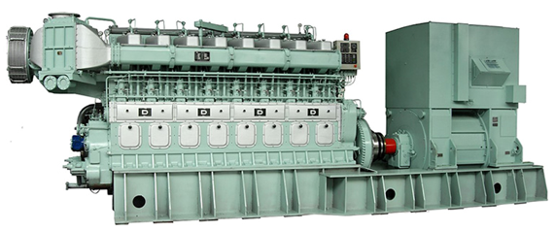
4-stroke ICE (G/E)
Generator side
Engine side
Engine side
Generator side
Imagine
a generator connected to a shaft instead of a propeller.

Slide 15
4-stroke ICE (G/E)
Since the generator side is probably covered in the class of "Marine Electrical and Electronic Engineering," this class (Internal Combustion Engine) only focuses on the engine side.

Slide 16
Compressed Air System for G/E

Slide 17
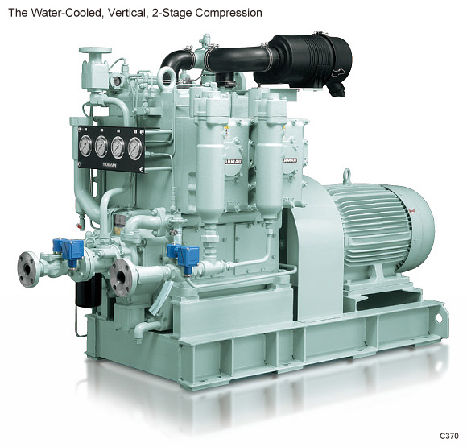
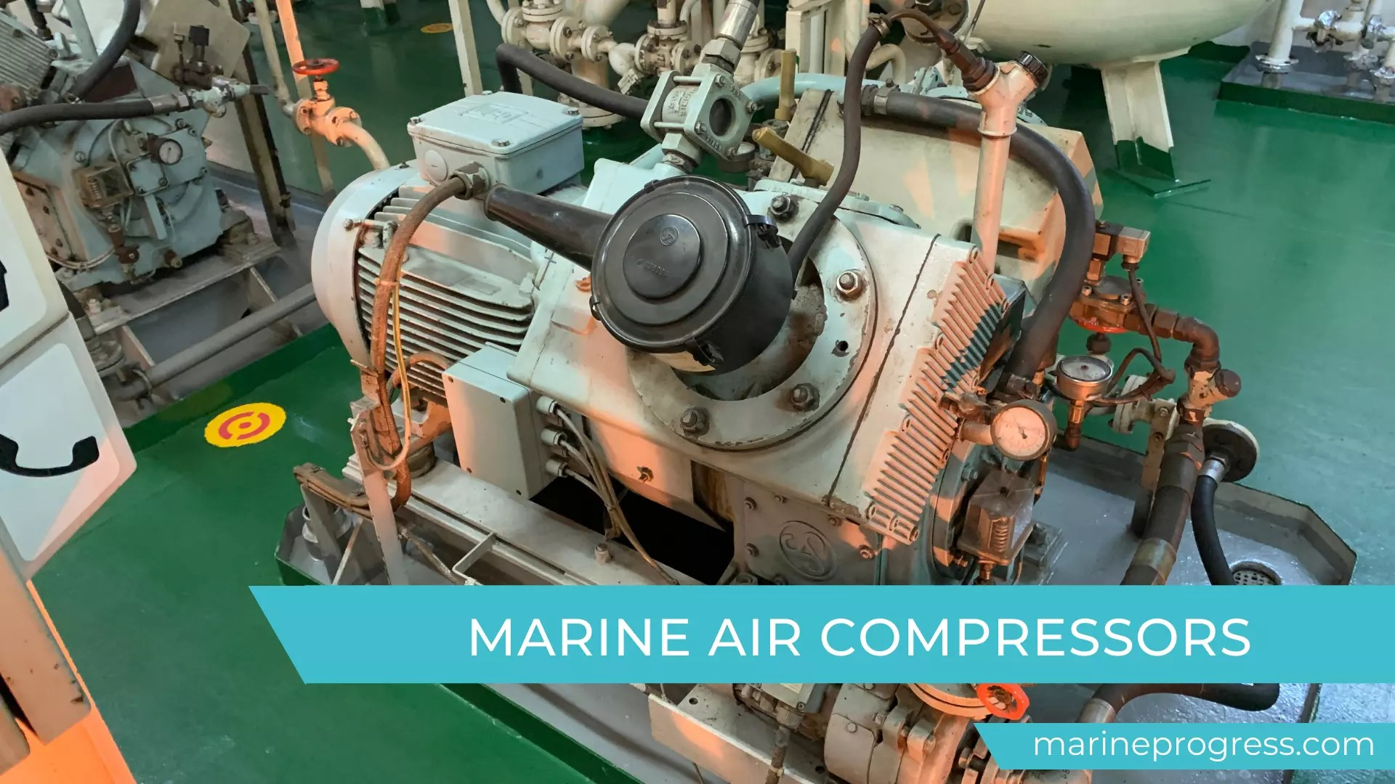
Marine air compressor
How does G/E start?
To answer this, you need to understand the Compressed Air System.
There are 2 to 3 air compressors installed on the ship, and they look like below.
Motor
Air compressor

Slide 18
4-stroke ICE (G/E)
The engine side of the G/E and air compressor have a similar structure.
The differences between the driving mechanisms of G/E and air compressor are as follows.
G/E creates a reciprocating motion of the piston by the explosive force from the combustion of air and fuel, which rotates the crankshaft, and a generator is connected to the crankshaft to produce electricity.
Energy flow

Slide 19
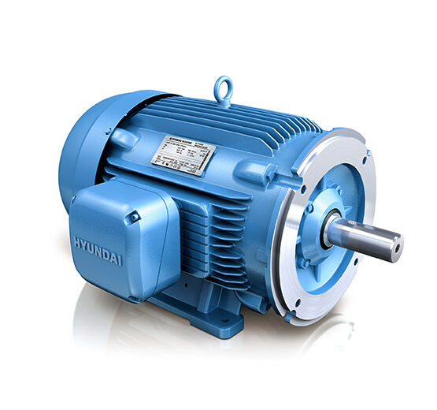
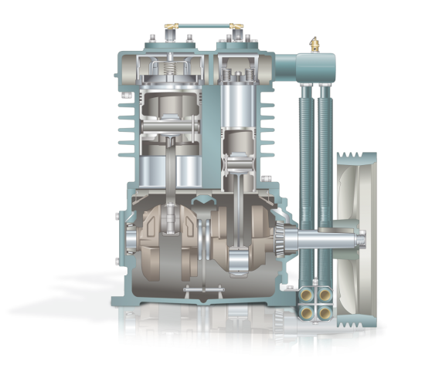
Marine air compressor
An air compressor has a crankshaft connected to the shaft of a motor, and the rotational force of the motor creates a reciprocating motion of a piston, which compresses the air and produces compressed air.
Energy flow
Motor rotational power

Slide 20
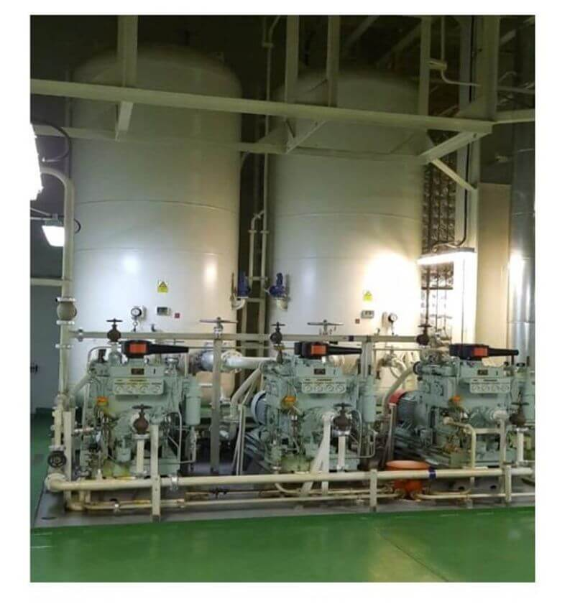
Marine air compressor
Compressed air produced by the air compressor is stored in air reservoir tanks for starting the M/E and G/E.
No. 1 air reservoir tank
No. 2 air reservoir tank
3 air compressors

Slide 21
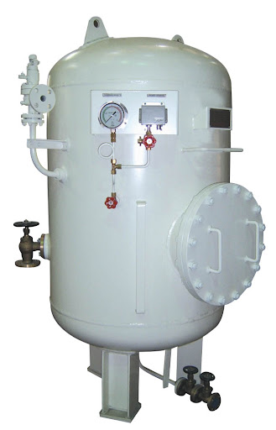
Air reservoir tank
The air reservoir tank is filled with compressed air, and there is condensed water at the very bottom of the tank, so the apprentice engineer usually opens the drain valve to drain it in the morning and at afternoon.
The reason for draining is that if moisture is mixed in the compressed air and flows into the M/E or G/E when they are started, there is a possibility that it will cause a damage and malfunction.
The actual air reservoir tank on a ship is not as small as the picture on the left, but is very large as shown in the picture on the previous slide.
The left one might be the auxiliary air reservoir tank .
Clockwise: Valve close
Counterclockwise: Valve open
Water drain valves

Slide 22
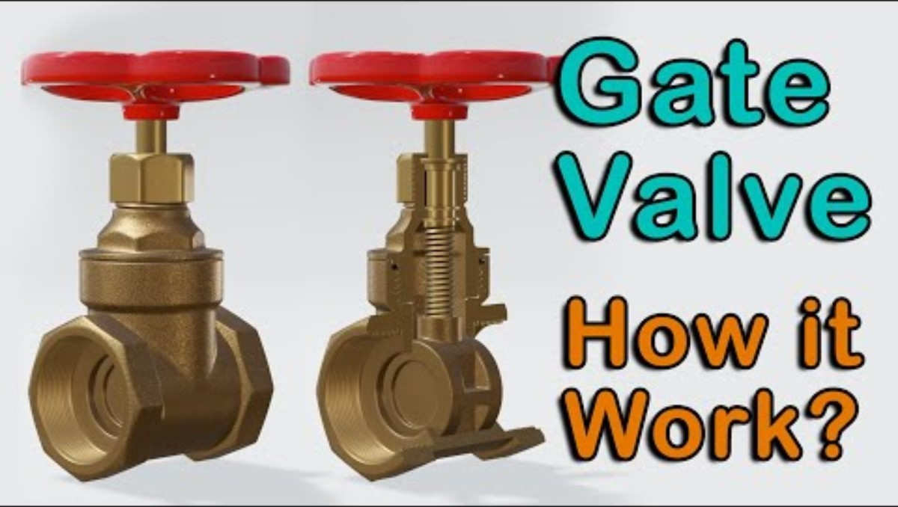
Valve

Slide 23
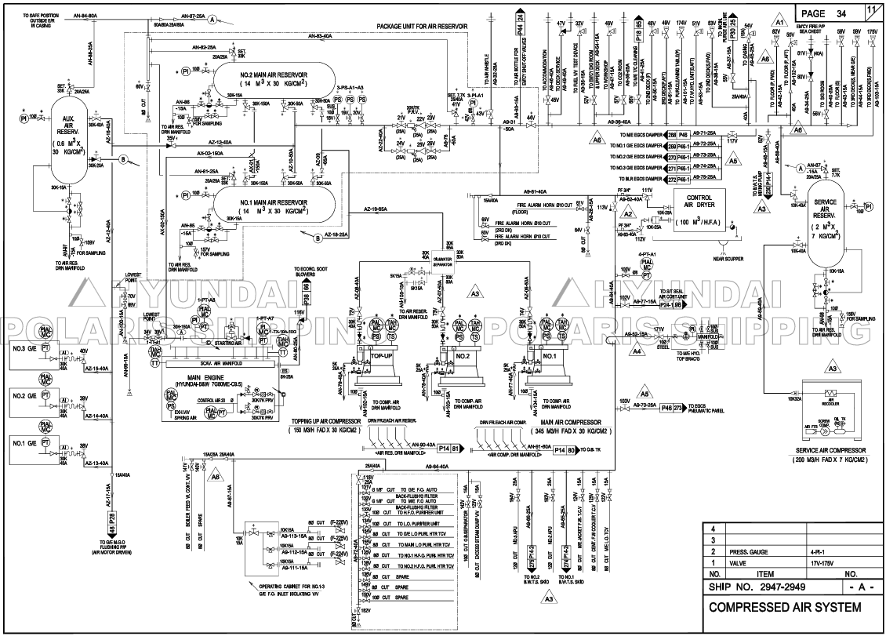
Oil&Water Separator

Slide 24
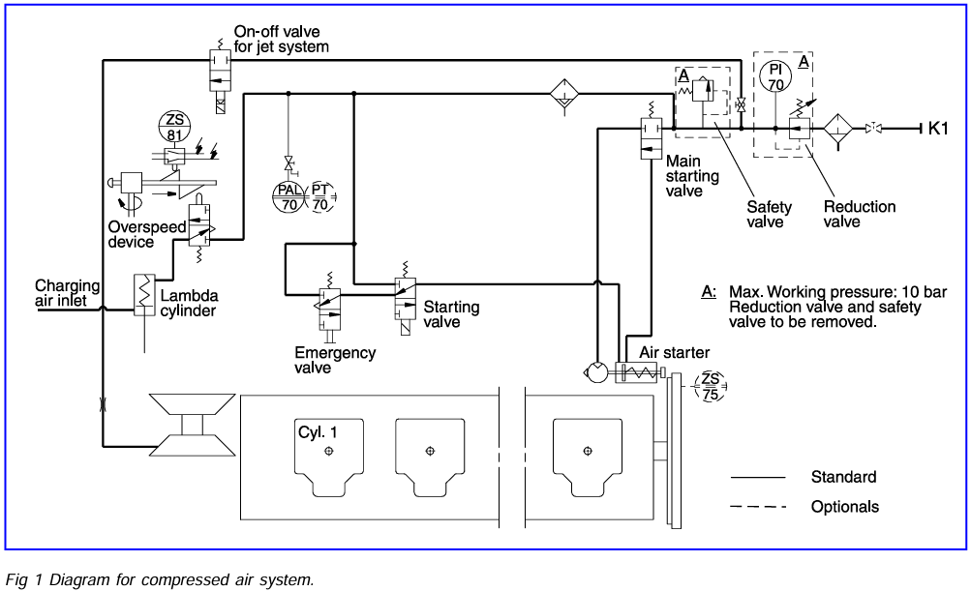
Compressed Air System of G/E

Slide 25
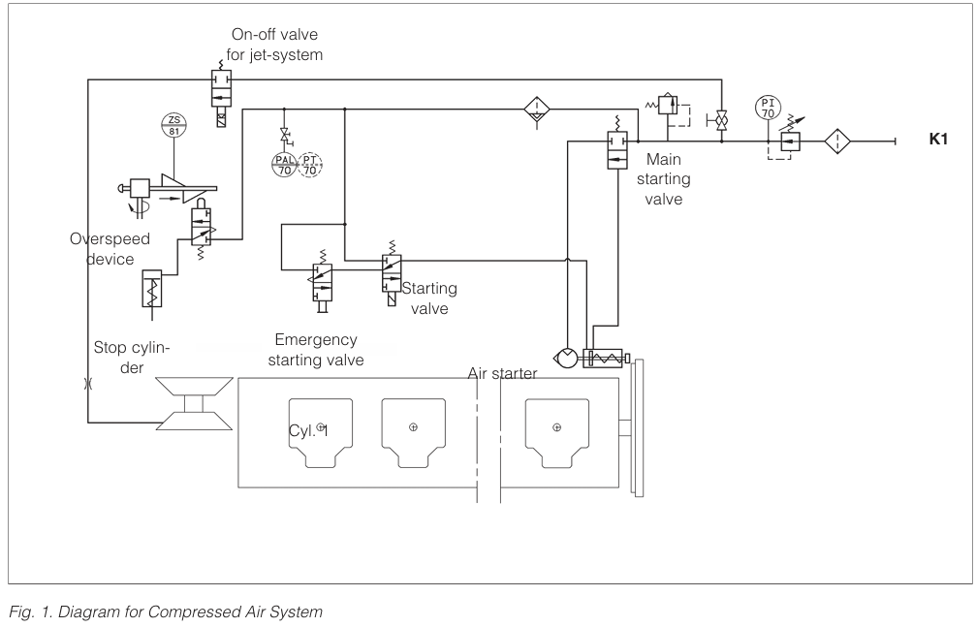
Compressed Air System of G/E

Slide 26
Compressed Air System of G/E
The compressed air is continuously supplied from the starting air
receivers (30 bar) through a reduction station to the Compressed Air System of G/E.
1 atm = 1.01325 bar
atm = atmospheres

Slide 27
Compressed Air System of G/E
The air starter is activated with a pneumatic 3/2 way solenoid valve (starting valve).
The air starter can be activated manually from the starting box on the engine, and it can be activated by remote control, manual or automatic.
When the starting valve is opened, air will be supplied to the drive shaft housing of the air starter.
(Pneumatic 3/2 way
solenoid valve)

Slide 28
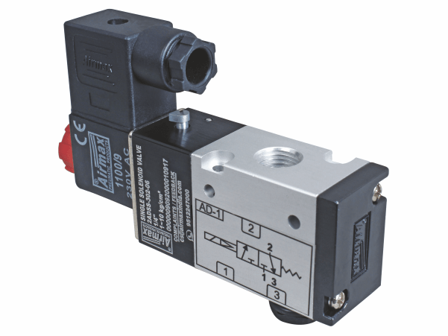
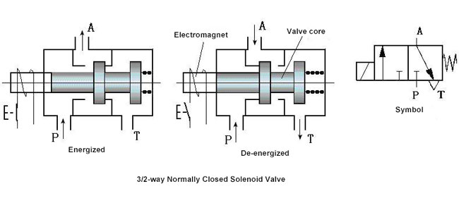
Compressed Air System of G/E
(Pneumatic 3/2 way
solenoid valve)

Slide 29
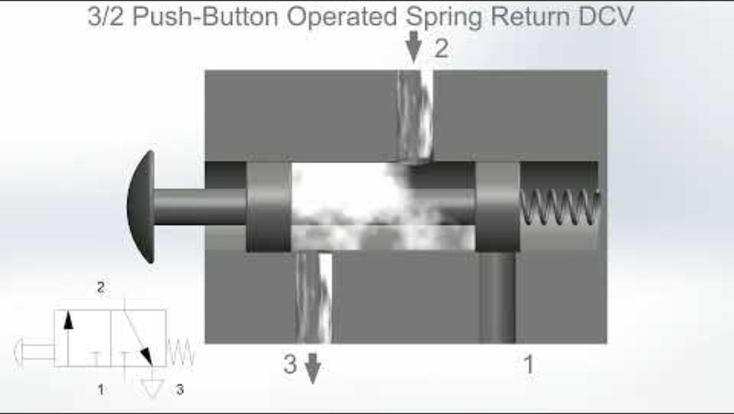
Compressed Air System of G/E

Slide 30
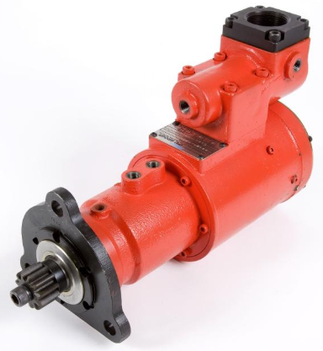
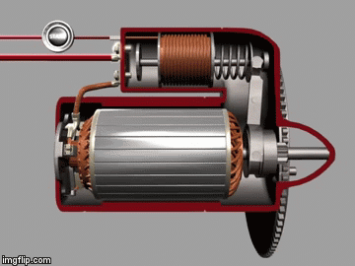
Compressed Air System of G/E
Drive pinion
Air starter
The air supply will - by activating a piston - bring the drive pinion into engagement with the gear rim on the engine flywheel.
Drive pinion
Push
(Pneumatic 3/2 way
solenoid valve)
Gear rim
This animation illustrates the engagement of the air starter's drive pinion and the gear rim on the engine flywheel. On ships, air starter is driven by compressed air, not electricity.
Engine flywheel

Slide 31
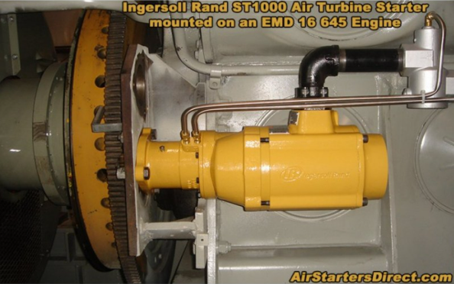
Compressed Air System of G/E
Air starter
Drive pinion
Engine flywheel
Gear rim of flywheel
Example of an air starter installed in a G/E

Slide 32
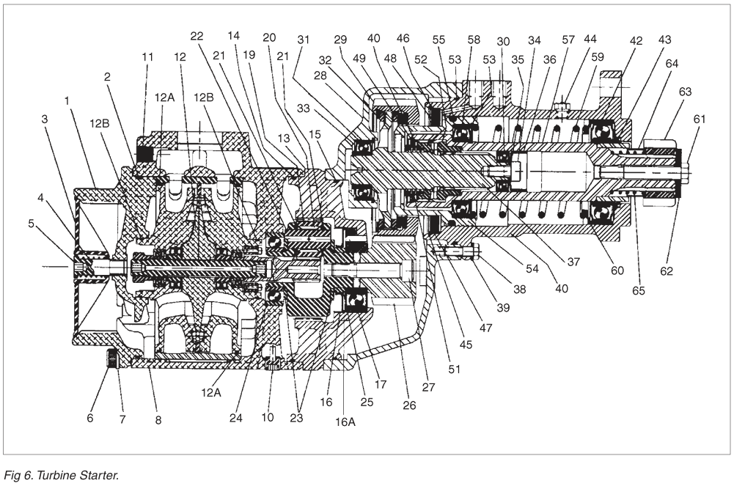
Compressed Air System of G/E
Drive pinion
Example of an air starter (turbine starter) installed in a G/E

Slide 33
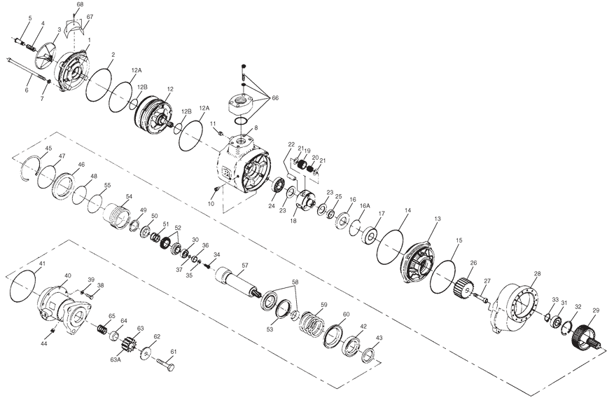
Compressed Air System of G/E
Exploded view of the air starter
: Bearing
: O-ring
Drive pinion

Slide 34

Ball bearing

Slide 35
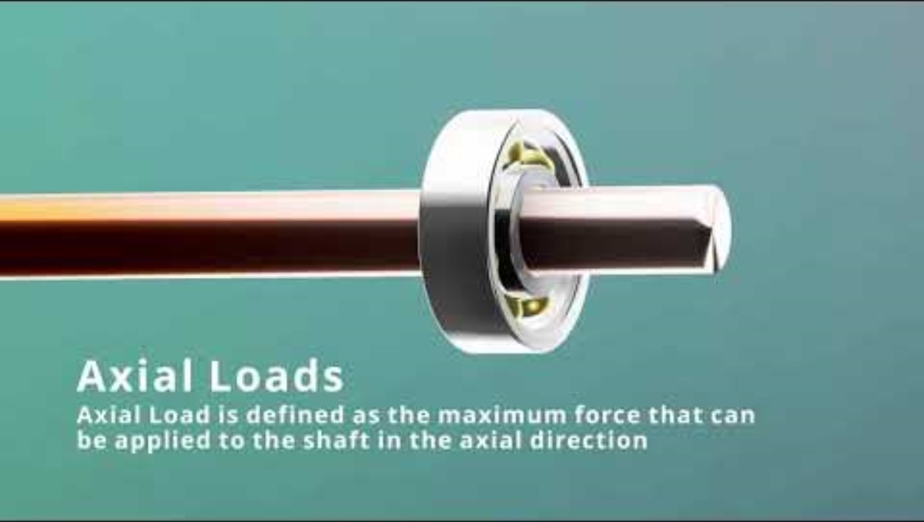
Ball bearing

Slide 36
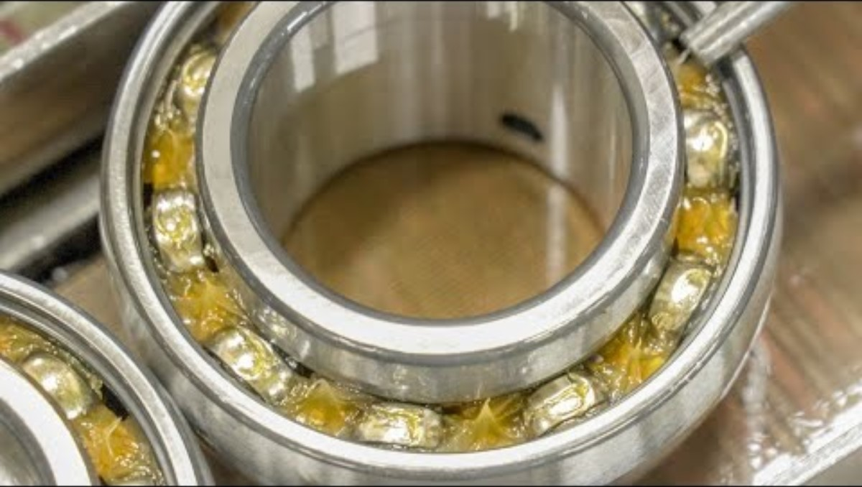
Ball bearing

Slide 37
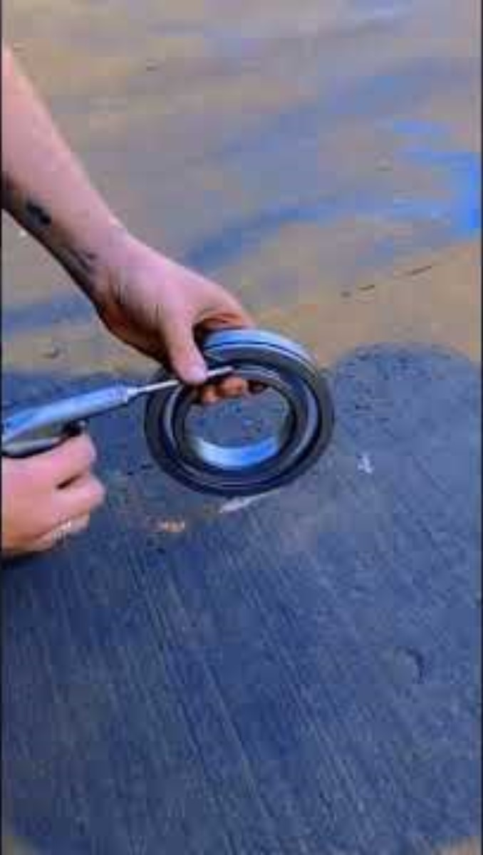
Ball bearing

Slide 38
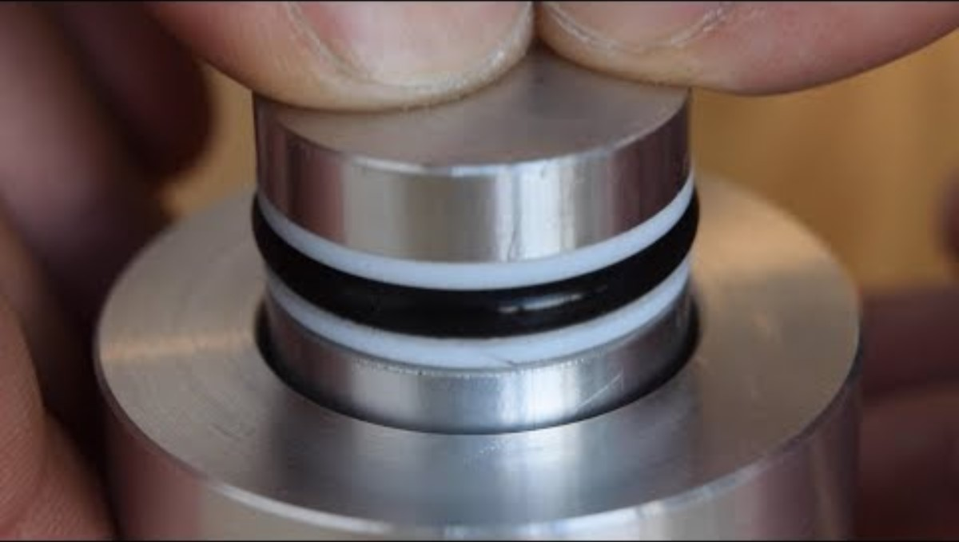
O-ring

Slide 39
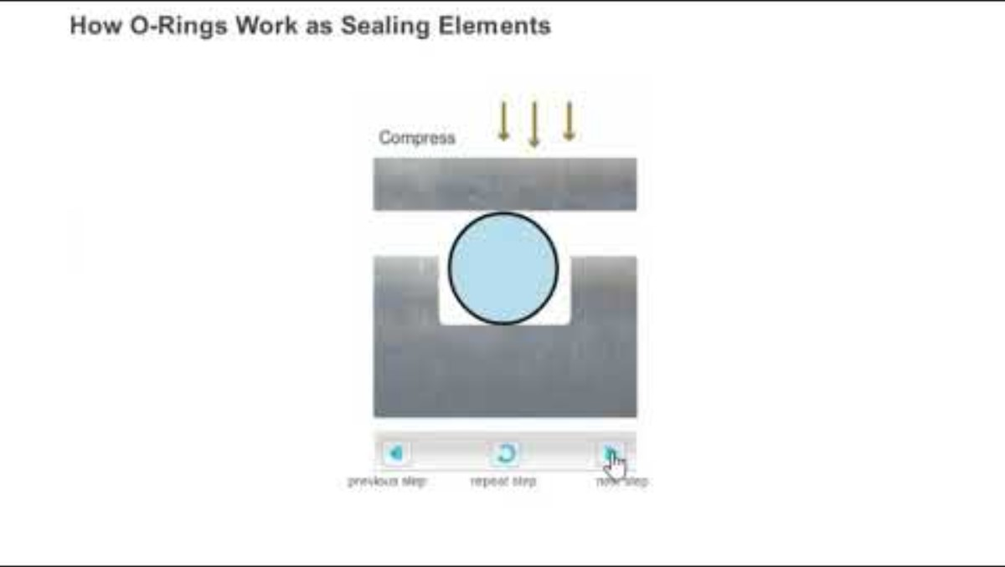
O-ring

Slide 40
O-ring
https://www.youtube.com/shorts/o-Qs2qcS4dU

Slide 41
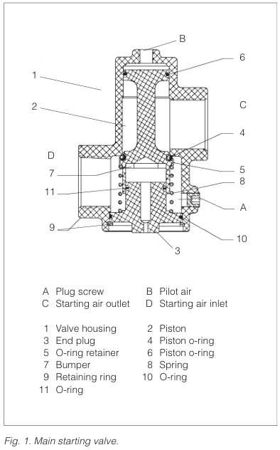
Compressed Air System of G/E
Turn
Drive pinion
When the pinion is fully engaged,
the pilot air will flow to, and open the main starting valve, whereby air will be led to the air starter, which will start to turn the engine.
When the RPM exceeds approximately 110 (depends on G/E model), at which firing has taken place, the starting valve is closed whereby the air starter is disengaged.
(Pneumatic 3/2 way
solenoid valve)
Engine flywheel

Slide 42
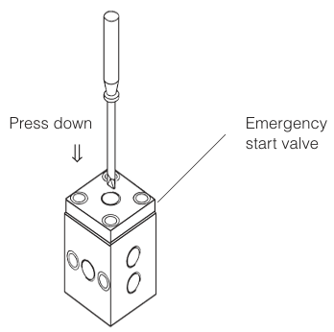
Compressed Air System of G/E
The system is equipped with an emergency
starting valve which makes it possible to activate the air starter manually in case of a power failure.
The emergency starting valve is activated by means of a screw-driver or similar.
Turn
Drive pinion
(Pneumatic 3/2 way
solenoid valve)
Engine flywheel

Slide 43
Compressed Air System of G/E
Main starting valve
Compressed air from starting valve
Air starter
Drive pinion
G/E
Engine flywheel
Example of an air starter installed in a G/E

Slide 44
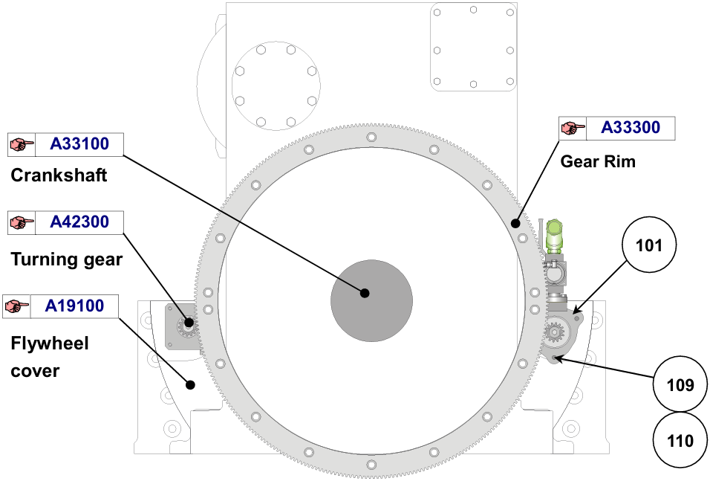
Compressed Air System of G/E
Starting air motor (=Air starter)

Slide 45
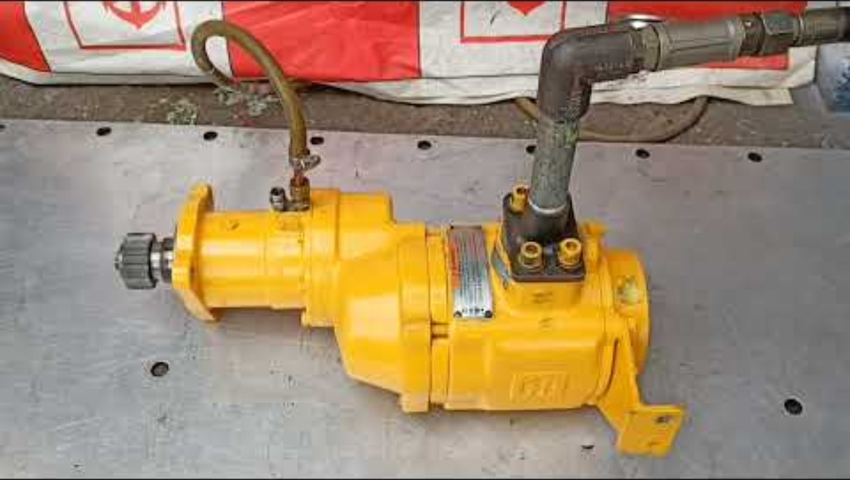
Compressed Air System of G/E

Slide 46
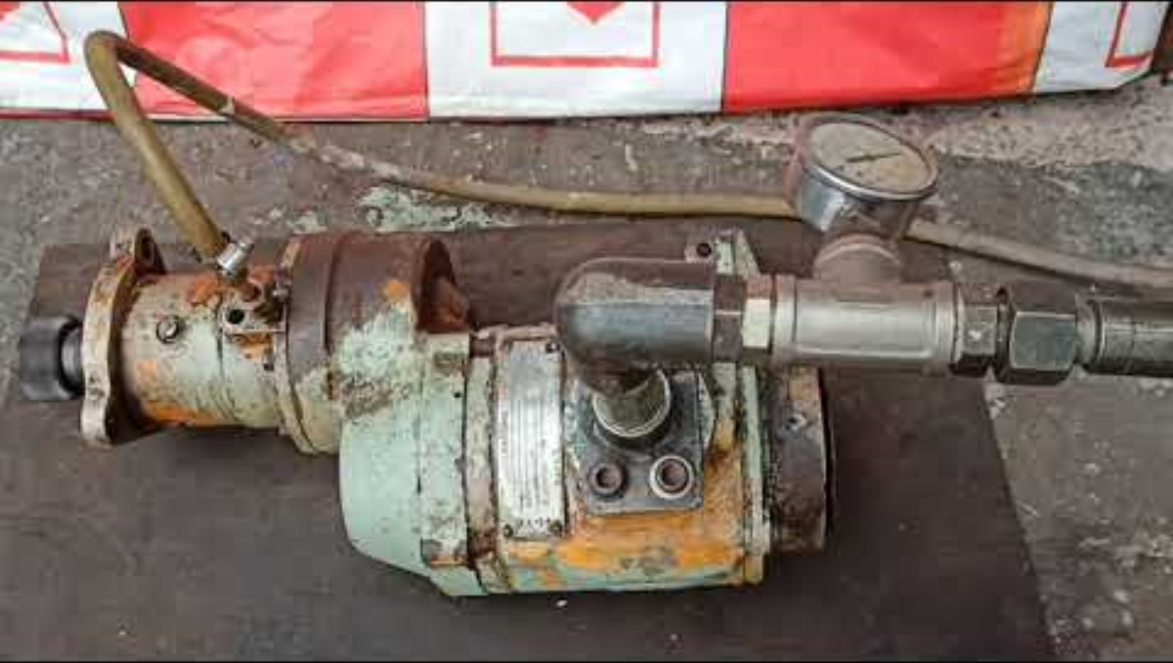
Compressed Air System of G/E

Slide 47
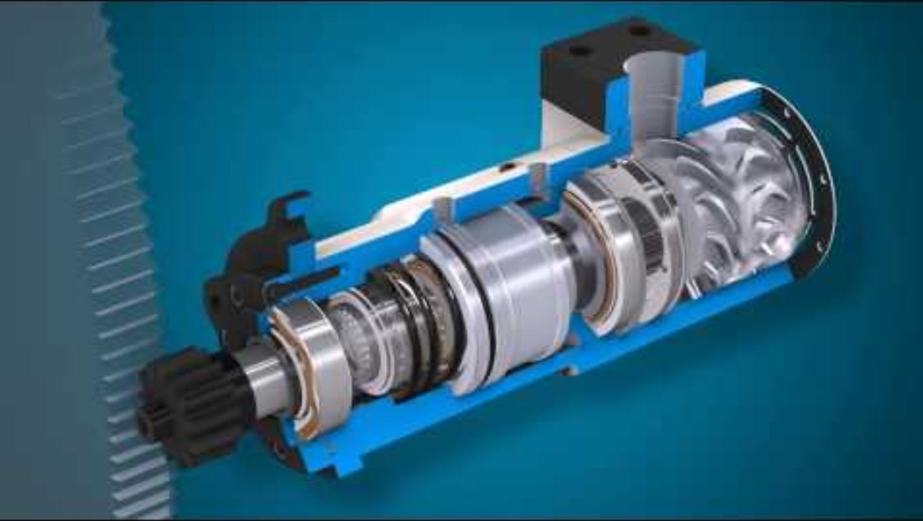
Compressed Air System of G/E

Slide 48
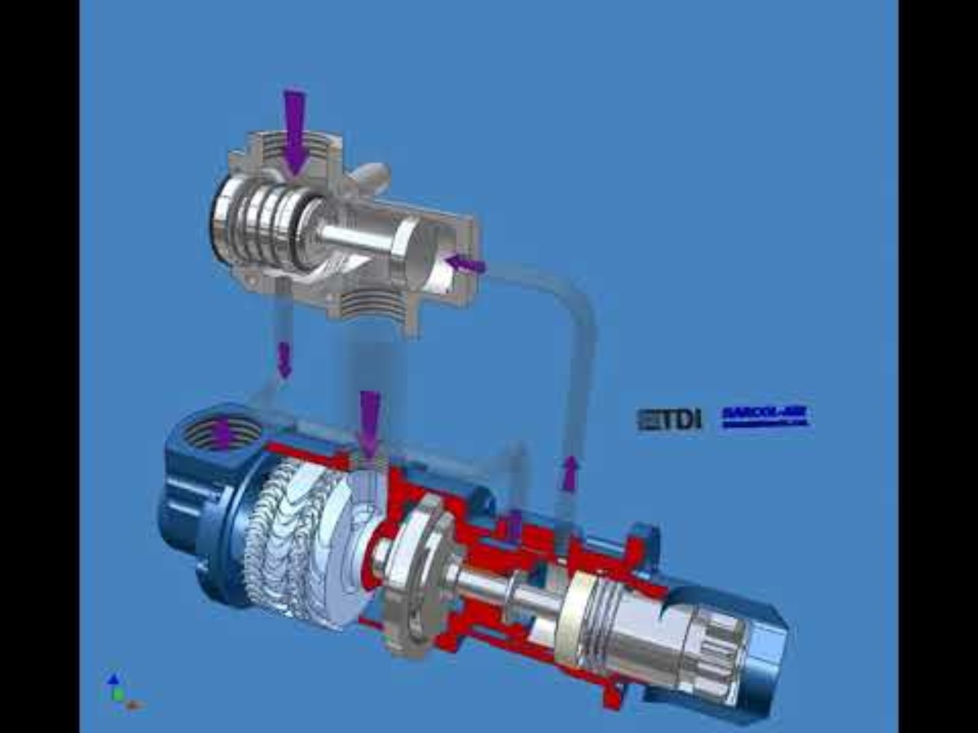
Compressed Air System of G/E

Slide 49
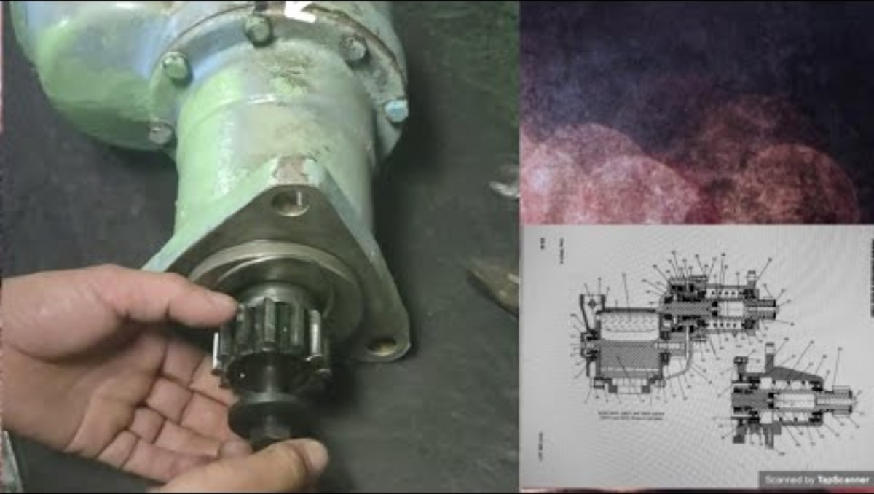
Compressed Air System of G/E

Slide 50
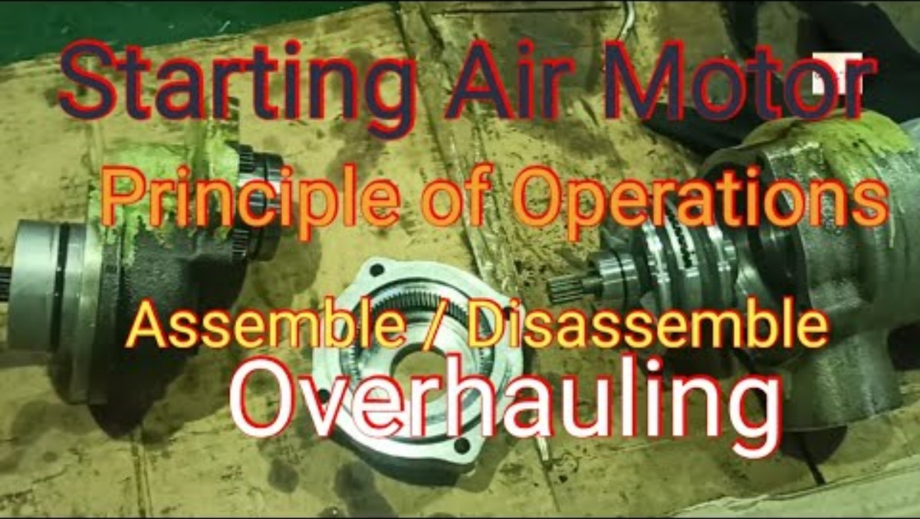
Compressed Air System of G/E

Slide 51
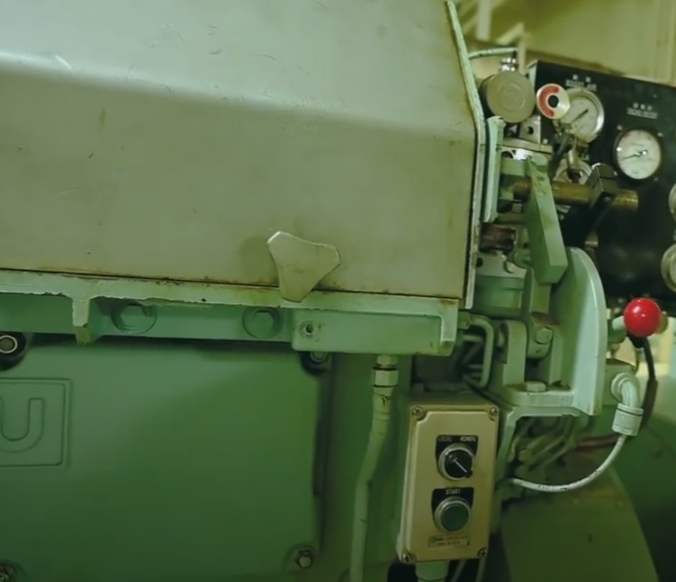

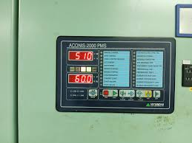

Start & stop panel for G/E (HiMSEN)
‘START’ button on the control panel activates starting solenoid valve opened to supply compressed air into the starting air motor. Then, the pinion of the air starting motor is engaged with the gear rim of the engine flywheel and turns crankshaft of the engine.
Hence, when the engine rotating speed reaches predetermined speed, fuel oil is injected into the combustion chamber for self-rotating. Then, starting is completed and the pinion of the air starting motor is disengaged from the gear rim at predetermined speed.
Start
Stop
Start
It is located next to G/E.
Stop
Start
It is located on the main switchboard in the engine control room.

Slide 52
References
1) https://www1.grc.nasa.gov/beginners-guide-to-aeronautics/zeroth-law-thermal-equilibrium/
2) https://www.grc.nasa.gov/www/k-12/airplane/thermo1.html
3) https://www1.grc.nasa.gov/beginners-guide-to-aeronautics/second-law-entropy/
4) https://en.wikipedia.org/wiki/Third_law_of_thermodynamics
5) https://www.chemistrylearner.com/laws-of-thermodynamics/third-law-of-thermodynamics
6) https://en.yna.co.kr/view/PYH20240129103500315
7) https://veig-bx.com/creating-a-powerful-new-identity
8) https://ko.wikipedia.org/wiki/%ED%8C%8C%EC%9D%BC:Hyundai_Heavy_Industries_logo_%28english%29.svg

Slide 53
References
9) https://www.soar.hk/marinegenset4_en/
10) https://jamestroop.co.uk/partner/diahatsu/
11) https://www.yanmar.com/global/powergeneration/products/diesel_generators/
12) https://ancasta.com/yacht-services/yanmar-dealer/
13) https://www.maritimenetwork.dk/en/everllence/
14) https://www.tradekorea.com/product/detail/P358813/STX-Man-6L-23-30-H-marine-generator-set.html
15) https://www.everllence.com/
16) https://smiec.co.id/brand/

Slide 54
References
17) https://loadbanks.com/man_diesel_turbo/
18) https://www.valantic.com/en/case-studies/aps-waysuite-at-man-es-production-planning-ai-optimized/
19) https://ko.wikipedia.org/wiki/%ED%8C%8C%EC%9D%BC:W%C3%A4rtsil%C3%A4_logo.png
20) https://www.indiamart.com/proddetail/wartsila-6l20-8l20-6r32-8r32-marine-engine-generator-21468731848.html?srsltid=AfmBOoqGrbLB1O_IaM-igeHRohnLyemvmJiopZJViot2mGX5l2TSdmov
21) https://medium.com/@Breadarose/what-is-the-lifespan-of-a-typical-diesel-electric-generator-f47cc962de17
22) https://kr.pinterest.com/pin/315392780158380877/
23) https://tenor.com/ko/search/ac-generator-gif-gifs
24) https://yesway.co.uk/smart-ships-generator-how-they-work-fail/

Slide 55
References
25) https://www.csi-es.com/product/csi-ningdong-gn320-series-marine-diesel-generator-set-1500-2200kw/
26) https://wildonengineering.com.au/marine-compressor-factors-to-consider-for-seaworthy-performance/
27) https://marineprogress.com/marine-air-compressors/
28) https://us.fscurtis.com/product/ml-series/
29) https://www.marineinsight.com/tech/air-compressor/compressed-air-line-on-ships/
30) https://cdn1.shipserv.com/ShipServ/pages/profiles/200862/documents/MAN-L28-32H_CODE-BOOK_GALUAL.pdf
31) https://www.atosolenoidvalves.com/how-does-3-2-pneumatic-solenoid-valve-work.html
32) https://www.airmaxindia.com/3-2-way-single-solenoid-valves/

Slide 56
References
33) https://in.pinterest.com/pin/584271751649916183/
34) https://www.ipu.co.uk/products/air-starters/
35) https://airstartersdirect.com/turbine-air-starters/st1060bi03r31s-2g/?srsltid=AfmBOootgZX8KfjmFq-SgP3sxLzXgxbJtX-HVnSim8YFqevmt2PxYHFO
36) https://khinzawshwecom.wordpress.com/wp-content/uploads/2018/05/instruction-manual-for-shina-xin-an-sas-430.pdf
37) http://kkthebest.com/pressure-vessel/service-control-air-reservoir/
38) http://www.komeco.net/bbs/board.php?bo_table=products01_e&wr_id=14
39) https://www.facebook.com/groups/2755620331372660/posts/3598232350444783/
40) https://www.youtube.com/watch?v=0cLcnudOJWg
41) https://unsplash.com/ko/s/%EC%82%AC%EC%A7%84/engine-room

Slide 57
References
42) https://www.youtube.com/shorts/xfG1JyienUY
43) https://www.youtube.com/shorts/KzUHDCjN5OI
44) https://www.youtube.com/watch?v=gd3JaxileD8
45) https://www.youtube.com/watch?v=T53zdMvOPmE
46) https://www.youtube.com/shorts/o-Qs2qcS4dU
47) https://www.youtube.com/watch?v=aweDWuNkPw0
48) https://www.youtube.com/watch?v=kbjTQlkIho8
49) https://www.youtube.com/watch?v=3nq13KDcALg
50) https://www.youtube.com/watch?v=AhjyPhohbnU

